Slide 1
ADS:Coding and BST
Kamil Salakhiev

Slide 2
PCMS troubles☹
Scanner.nextFloat - doesn't work in PCMS.
You can use Float.parseFloat(Scanner.next())

Slide 3
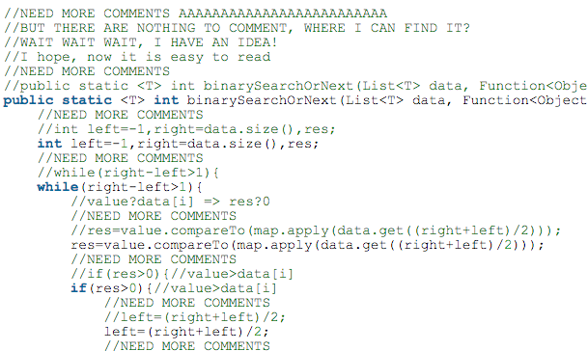
Garbage comments

Slide 4
Obvious comments
1: //Apply style
2: Apply(style);

Slide 5
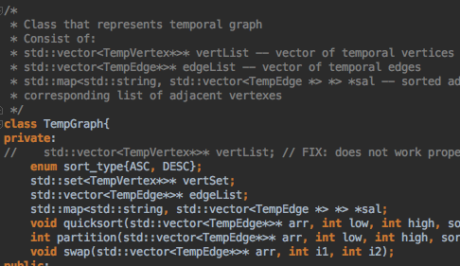
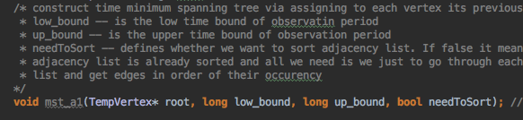
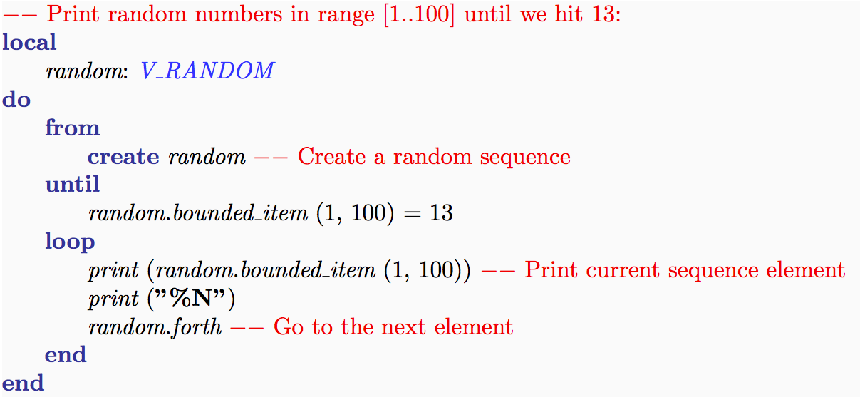
So, where to put comments?
In the head of the class
To explain what does your function do
In places that are hard to understand
Hi, Eiffel

Slide 6
Apply function understanding
Apply function is to convert passed object to its Comparable form
Function<Object, Comparable> map = t -> (Comparable)t;
Comparable s1 = map.apply(“abc”);
Comparable s2 = map.apply(“xyz”);
if (s1.compareTo(s2) < 0)
//do smth

Slide 7
Linked List to search and sorting!
Operation | Array-based | List-based
size() | O(1) | O(1)
isEmpty() | O(1) | O(1)
get(i) | O(1) | O(n)
set(I, v) | O(1) | O(n)
add(I, v) | O(n) | O(n)
remove(i) | O(n) | O(n)

Slide 8
Insertion Sort
for (int i = 1; i < data.size(); i++){ Comparable key = map.apply(data.get(i)); int j = i-1; while(j >= 0 && map.apply(data.get(j)).compareTo(key) > 0){ data.set(j, data.get(j+1)); j--; } data.set(j+1, data.get(i)); }

Slide 9
Hash Map: open addressing
private int hash(Object k) {
return k == null ? 0 : k.hashCode()%size;
}

Slide 10
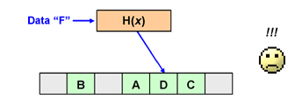
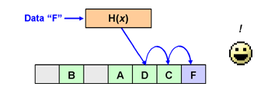
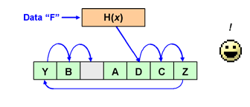
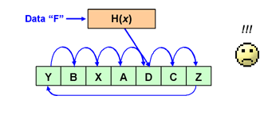
Linear Probing
1)
2)
3)
4)

Slide 11
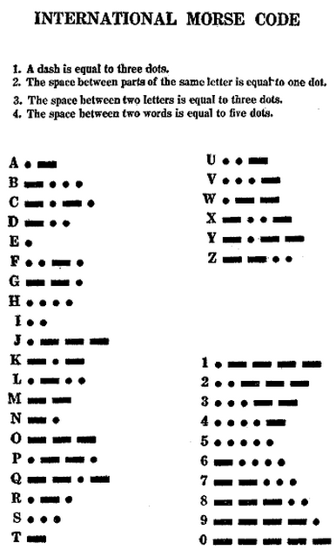
Coding
Features of good coding:
Efficiency
Speed
Simplicity

Slide 12
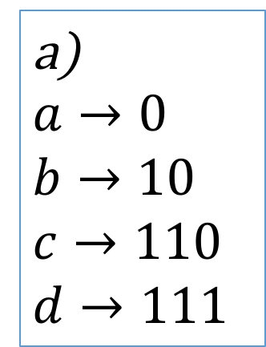
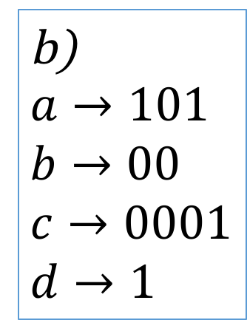

Prefix coding
Imagine we have alphabet $A=\{a,b,c,d\}$ and the following rules:
a)
$$a→0$$
$$b→10$$
$$c→110$$
$$d→111$$
b)
$$a→101$$
$$b→00$$
$$c→0001$$
$$d→1$$
011001111010
1101000001001
Prefix definition: sequence $a_{1}a_{2}…a_{n}$ is a prefix for sequence $b_{1}b_{2}…b_{m}$ if $n≤m$ and $a_{1}a_{2}…a_{n}=b_{1}b_{2}…b_{n}.$

Slide 13
Shannon-Fano coding
x_{i} | P(x_{i}) | Stage 1 | Stage 2 | Stage 3 | Stage 4 | Code
A | 0.30 | 0 | 0 | - | - | 00
B | 0.25 | 0 | 1 | - | - | 01
C | 0.20 | 1 | 0 | - | - | 10
D | 0.12 | 1 | 1 | 0 | - | 110
E | 0.08 | 1 | 1 | 1 | 0 | 1110
F | 0.05 | 1 | 1 | 1 | 1 | 1111

Slide 14
0
1
0
1
0
1
A
B
C
0
1
C
0
1
E
0
1
F
G

Slide 15
Exercise!
Build Shannon-Fano coding for the following alphabet:
P(A)=0,55 P(B)=0,33 P(C)=0,11 P(D)=0,01

Slide 16
Huffman coding
A
0,30
B
0,25
C
0,20
D
0,12
E
0,08
F
0,05
0,55
0,13
0,25
0,45
1

Slide 17
Exercise!
Construct a Huffman tree for alphabet with the following probabilities:
P(A)=0,35 P(B)=0,2 P(C)=0,2 P(D)=0,15 P(E)=0,1

Slide 18
Binary search tree
For any node with key x all nodes in the left subtree have keys < x while all keys in right subtree have values >x
8
3
10
1
6
14
4
7
13

Slide 19
Binary search tree(cont.)
The basic operations, supported by BST are:
Search
Traversal
Insertion
Deletion

Slide 20
Search
Target:
4
8
3
10
1
6
14
4
7
13

Slide 21
Insertion
To insert:
5
8
3
10
1
6
14
4
7
13
5

Slide 22
Deletion
To deletion performing there are 3 cases:
Delete node without child nodes
Delete node with 1 child
Delete node with 2 childs

Slide 23
Deletion: node without childs (key = 4)
8
8
3
10
3
10
1
6
14
1
6
14
7
13
7
13
4

Slide 24
Deletion:node with 1 child (key = 10)
8
8
3
10
3
14
1
6
14
1
6
13
4
7
13
4
7

Slide 25
Deletion:node with 2 childs (key = 3)
8
8
3
10
4
10
1
6
14
1
6
14
4
7
13
7
13

Slide 26
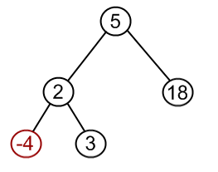
Exercise!

Slide 27
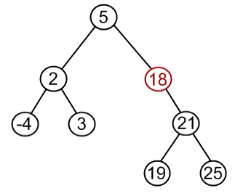
Exercise!

Slide 28
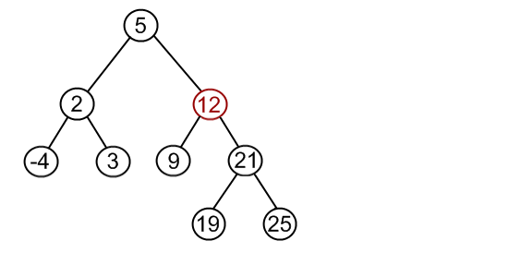
Exercise!

